Slide 1
Inheritance (polymorphic behavior)

Slide 2
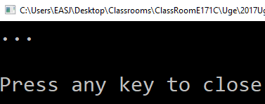
Animal
public void Sound()
{
Console.WriteLine("…");
}
Animal a = new Animal(…);
a.Sound();

Slide 3
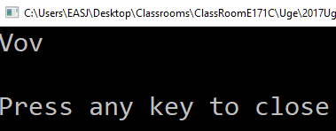
Dog
public void Sound()
{
Console.WriteLine("Vov");
}
Dog d = new Dog(…);
d.Sound();

Slide 4

Animal
Animal a = new Dog(…);
a.Sound();
Dog

Slide 5
Animal
public virtual void Sound()
{
Console.WriteLine("…");
}
public override void Sound()
{
Console.WriteLine("Vov");
}
Dog

Slide 6
Animal
Animal a = new Dog(…);
a.Sound();
Dog
Polymorphic behavior

Slide 7

Animal a = new Dog(…);
a.Sound();
Animal
Dog
Vov
a
Sound(); // Dog version

Slide 8

List<Animal> zoo = new List<Animal>();
zoo.Add(new Cat(…));
zoo.Add(new Dog(…));
zoo.Add(new Cat(…));
foreach (Animal a in zoo)
{
a.Sound();
}
List<Animal>
Cat
Miav
Dog
Vov
Cat
Miav

Slide 9
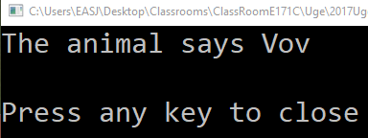
Animal
public virtual void Sound()
{
Console.Write("The animal says ");
}
public override void Sound()
{
base.Sound();
Console.WriteLine("Vov");
}
Dog

